Slide 1
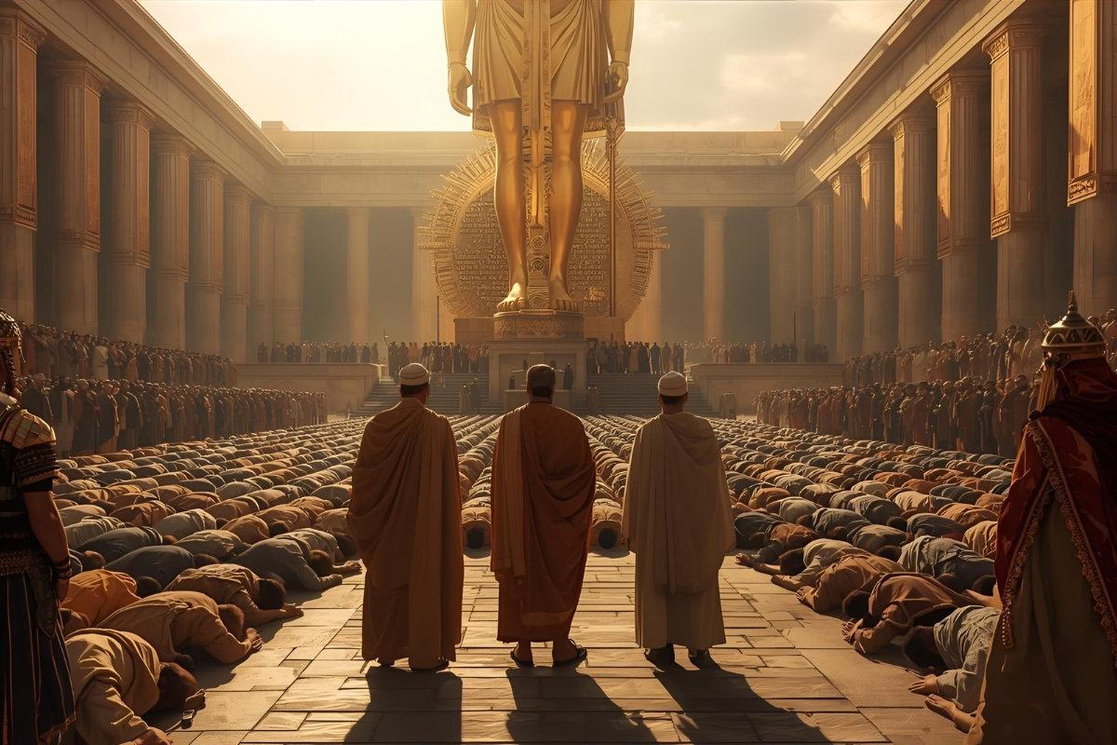
Dare to be Daniel: Daniel 3 The Fiery Furnace

Slide 2
Discussion
Discussion Question:
1.What cost do Christians face around the world for following Jesus?
2. What is the cost or pressure that you face or could you face for following Jesus?

Slide 3
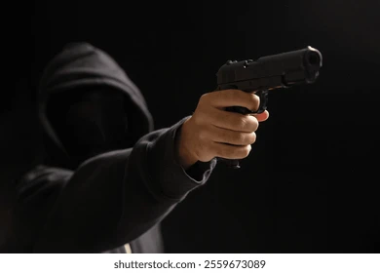
Give up Christ or Die??? What you going to do??

Slide 4
Daniel 3
We are going to look at four different groups and ask: What are their eyes on? And which Group are we most like?
1. Nebuchadnezzar
2. Conformers
3. Informers
4. Transformers

Slide 5
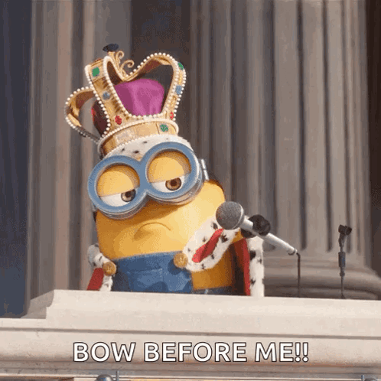
1. Nebuchadnezzar

Slide 6
Verse 3
He has erected a complete image of gold, sixty cubits in height, and breadth six cubits
Sixty cubits = 90 feet

Slide 7
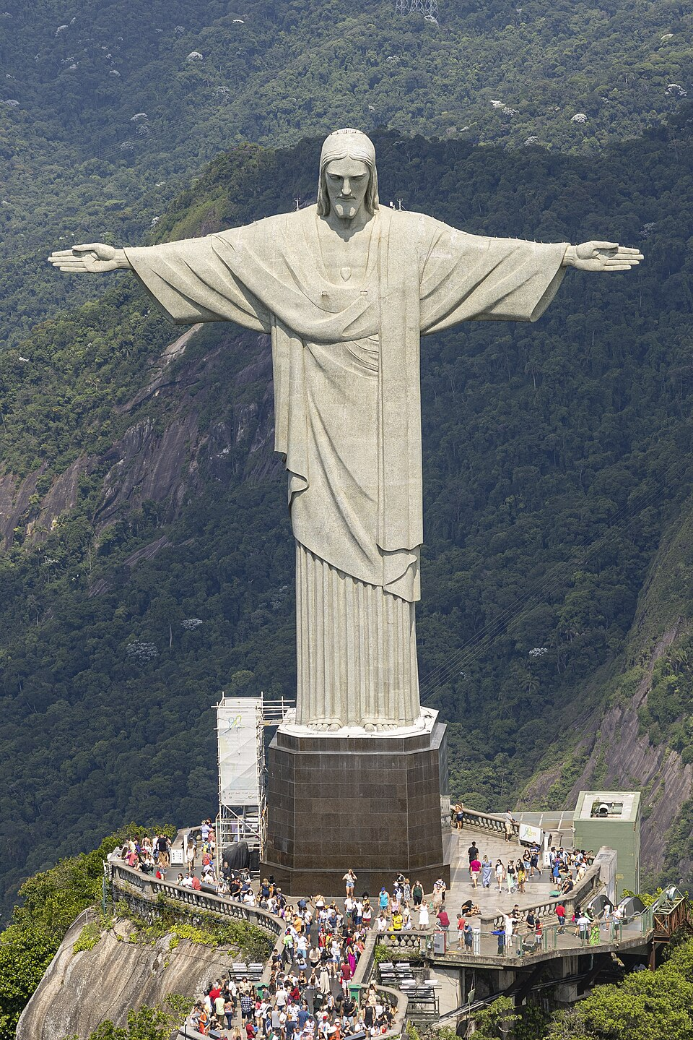
Christ the Redeemer Statue in Rio
98 feet

Slide 8
Verse 4-7
When You hear the music you will bow to this image
You will bow to me

Slide 9
1. Nebuchadnezzar

Slide 10
Did you catch that:
“Who is the god who will deliver you out of my hands.”
His view of the LORD is small, his eyes are on himself. It’s look at me, worship me.

Slide 11
Isn’t this Us also???
Take this S and N off SIN and what do you get?
“I”
We put ourself on the Throne, we say I’m in charge of my life, not you Lord.

Slide 12
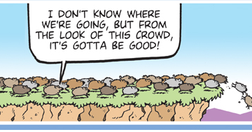
2. Conformers

Slide 13
2. Conformers
Verse 2-3
All the leaders and official are Gathered
They hear the proclamation and threat?
Verse 7
They Bow and worship the Image

Slide 14
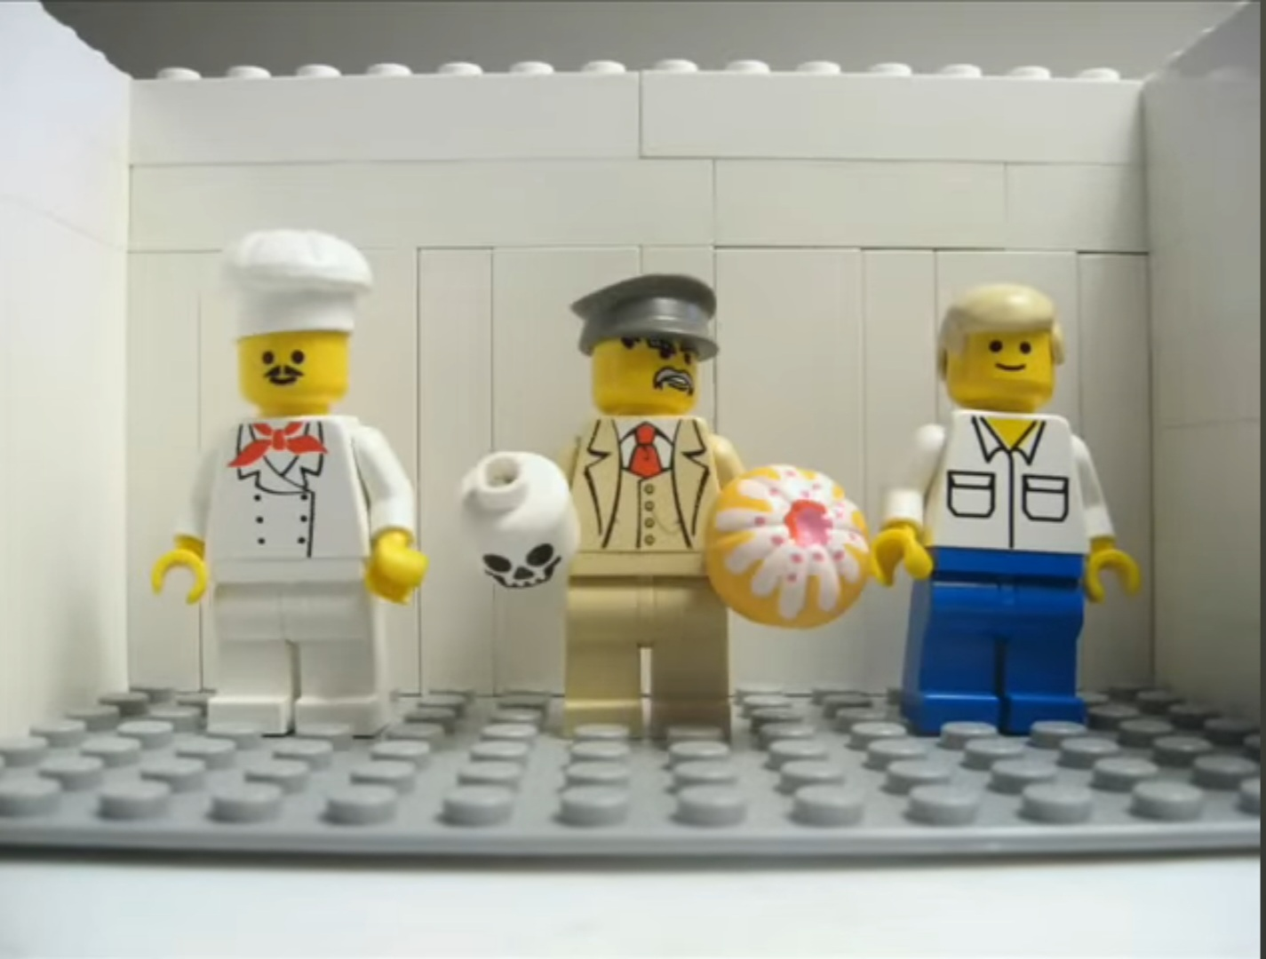
Cake or Death???

Slide 15
What is their view of God???
It small
They fear Man not God!

Slide 16


Slide 17
Today would we bow to the statue?
“And do not fear those who kill the body but cannot kill the soul. Rather fear him who can destroy both soul and body in hell”
(Matthew 10:28)

Slide 18
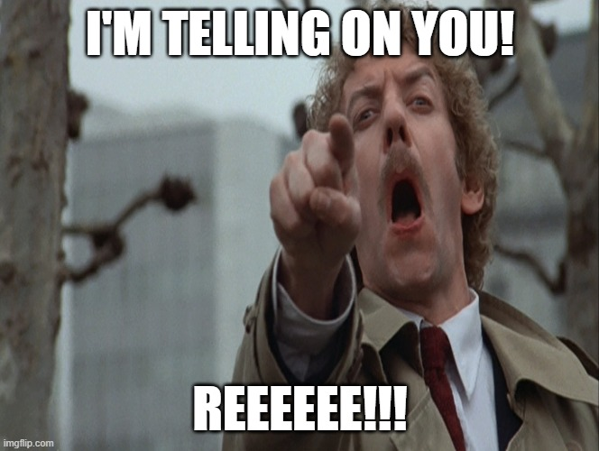
3. Informers

Slide 19
Verse 8-12
Some of conformers have become Informers!
They see group of people that not doing what they are doing, and attack…..
These men, O King, pay no attention to you; they do not serve your gods or worship the golden image that you have set up.

Slide 20
What is their view of God?
It’s like conformers – Fear of man, not fear of God
Their worldview is being challenged

Slide 21
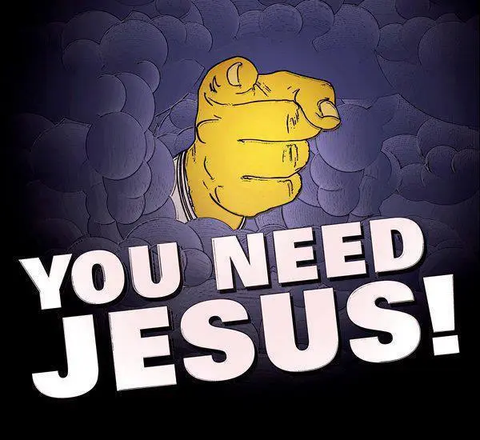
Salt and Light (Matthew 5:13-16)

Slide 22
They will hate you because they hate Jesus
John 15:18-21
Matthew 5:11
Your life is pointing to people that they are not right with God and need Jesus

Slide 23
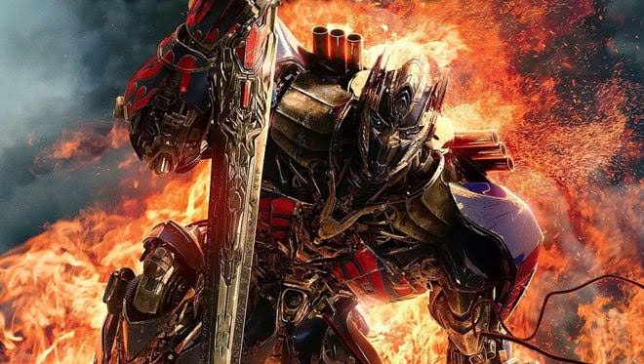
4. Transformers

Slide 24
Who is the God who will deliver you out of my hand?
THE LORD! THE GREAT I AM who led the people of Israel out of Slavery in Egypt
Who commanded not to bow to Idols (Exodus 20:2-5)
Who made promises like Isaiah 41:10 and Isaiah 43:2

Slide 25
This is how you can say this:
He has power to save us and even if he doesn’t we will not bow or worship your gods or image (Verse 16-18)
“For to me to live is Christ, and to die is gain.” (Philippians 1:21)
The Gospel isn’t that we avoid storms or furnace or bad time.
It’s that we get Jesus and He’s enough, whatever outcome!

Slide 26
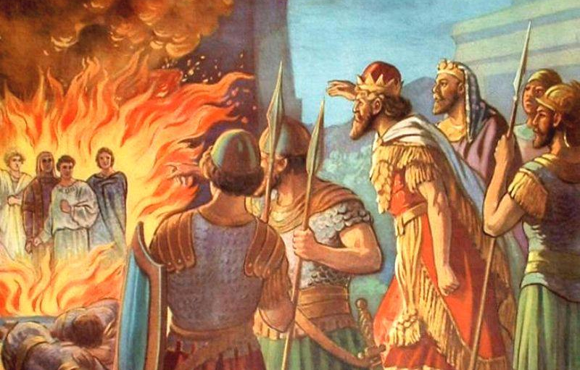
Nebuchadnezzar’s shock

Slide 27

Your faith in the furnace could lead other to Jesus

Slide 28
Let’s be Transformers, like Shadrach, Meshach and Abednego
Get Are eyes off man
Get them on The LORD:
Who created the Heavens and the Earth
Who reigns and in control
Who rescued Shadrach, Meshach and Abednego from the Furnace
Who rescued us from Sin and Death

