Slide 1
Dare to be a Daniel
Daniel 2:1-30
Daniel’s confidence

Slide 2
Questions
How would you respond in these situations and why?
The doctor has just called you in after a series of tests and gives you a very difficult diagnosis.
You work for a company testing a new product that is about to launch a new product in time for Christmas. The early tests showed the product was working well, but some recent results are not good. You know they want to get the product produced and out and have promised everyone a bonus if the deadline is met.
Do you share the new results with the Board or hold them back because your manager wants you to do that?

Slide 3
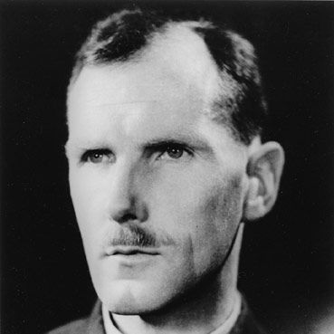
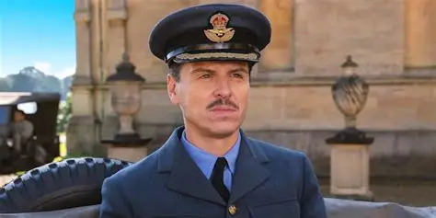
Under pressure
Notes:
Andrew Scott play Group Captain James Stagg. Chief Meteorologist at the time of D-Day he was advising whether they could go or not

Slide 4
The situation
Nebuchadnezzar had a dream that troubled him. 2:1
He called the wise men who ask him to tell the dream. 2:2-4
He refuses and indicates that he does not trust them. 2:5-6
They say what he is asking for is impossible because only the gods can do this and they are not available. 2:7-11.
In a fit of rage Nebuchadnezzar orders that they all be killed including Daniel and his three friends. 2:12-13
The situation is as dire as it could get.
Notes:
Notice their salutation – O King live for ever! V3 Here is a man who foolishly believes that he is going to live forever, and these men are affriming him in this delusion no wonder the dream troubled him.

Slide 5
How did Daniel respond?
He stayed calm. 2:14-16
He spoke with prudence and discretion. 2:14
He was granted further time. 2:16
He called his friends to pray and to ask God for mercy for them and the other wise men. 2:17
Notes:
Notice that Daniel is concerned for the other wise men, not just himself or his friends.

Slide 6
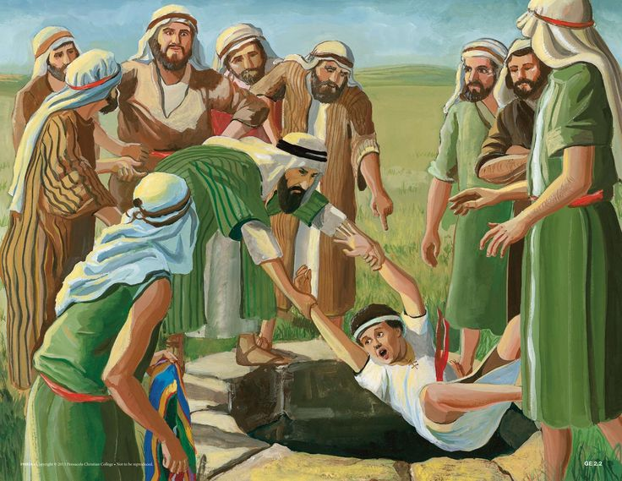
How was Daniel able to do this?
He has a personal relationship with God. 2:23
He prayed with confidence.
He knew Scripture Dan 9:2
  Story of Joseph Gen 37-50
    He was taken to a foreign land.
    He was faithful to God.
    God gave him favour with people.
    God enabled him to interpret dreams.

Slide 7
A wonderful answer!
God answered their prayers. 2:19
Daniel immediately praises and thanks God. 2:20-23
He goes to Nebuchadnezzar. 2:25
Daniel insists that it is God who has revealed this and it’s not by his own wisdom. 2:27-30
Notes:
Fear not trust God in all these, 14:1, Don’t be rattled the Message. One of the staff husband’s at the school. Daniel is one of many others who God has had stand before the rulers to declare him. Joseph stood before Pharoah, Elijah stood before King Ahab, Paul before Felix and Festus and probably the emperor nero himself. Notice the perspective Daniel has, the Lord is the one who is control of all people heraises kings up and sets them down. V21, He changes times and seasons. It is that absolute confidence that God is sovereign that helps Daniel.

Slide 8
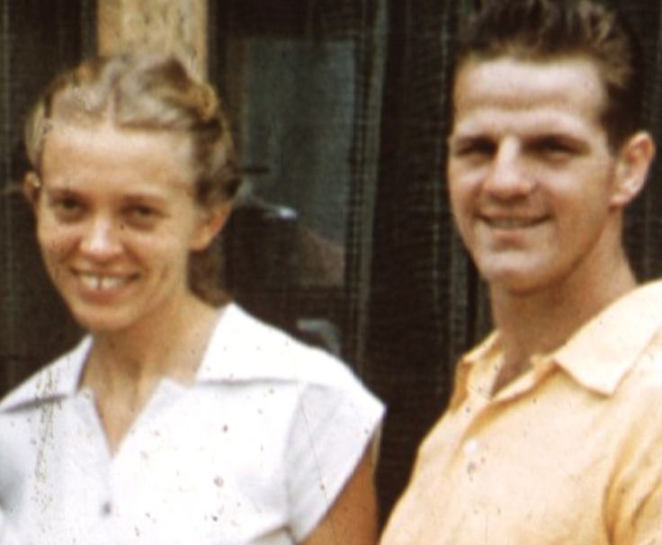
Application
This story was there to encourage the other Jews in exile that God had not abandoned them.
This passage is in Aramaic; it is something God wanted the Babylonians to know about too.
What seemed dire ended in promotion.
But God is still working even when the opposite seems to be the case. Romans 8:28
Remember James 5:17
Notes:
In 1952 he left for Ecuador with a desire to share the gospel with the Quechua Ketch-wah Indians also called the Auca mean savages in their own language. In 1953 he married another missionary Ellizabeth and then Jim tried to share the gospel. He was taken by an MAF pilot called Nate Saint.
Elijah was a man like us, I ma sure the same could be said about Daniel, this is what God had done with him and when needed he can do th same with you and I. Daniel is not afraid to make it clear that there is a God in heaven who has revealed this to him,so that Neb may know the future.

